Slide 1
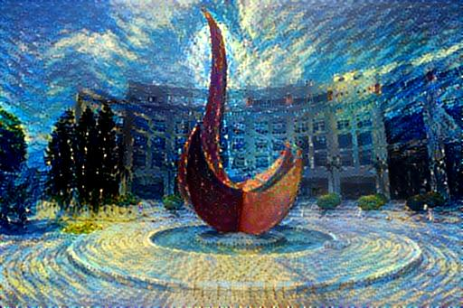
An Introduction to Convolutional Neural Networks
Yuan YAO
HKUST

Slide 2
Summary
We had covered so far
Linear models (linear and logistic regression) – always a good start, simple yet powerful
Model Assessment and Selection – basics for all methods
Trees, Random Forests, and Boosting – good for high dim mixed-type heterogeneous features
Support Vector Machines – good for small amount of data but high dim geometric features
Next, neural networks for unstructured data (image, language etc.):
Convolutional Neural Networks – image data
Generative models and GANs – new unsupervised learning for image, etc.
Recurrent Neural Networks, LSTM – sequence data
Transformer, BERT – machine translation etc.
Reinforcement Learning – Markov decision process, playing games, etc.

Slide 3
Kaggle survey: Top ML Methods
https://www.kaggle.com/surveys/2017
Academic
Industry

Slide 4
What type of data is used at work? https://www.kaggle.com/surveys/2017
Academic
Industry

Slide 5
Acknowledgement
https://stats385.github.io/
http://cs231n.github.io/
A following-up course at HKUST: https://deeplearning-math.github.io/

Slide 6
Some reference books on Deep Learning
Deep Learning with Python, Manning Publications 2017
by François Chollet
https://www.manning.com/books/deep-learning-with-python?a_aid=keras&a_bid=76564dff
Deep Learning, MIT Press 2016
By Ian Goodfellow, Yoshua Bengio, and Aaron Courville,
http://www.deeplearningbook.org/
Many other public resources

Slide 7
A Brief History of Neural Networks

Slide 8
Perceptron: single-layer

Slide 9
The Perceptron Algorithm
The Perceptron Algorithm is a Stochastic Gradient Descent method (Robbins–Monro 1950; Kiefer-Wolfowitz 1951) :

Slide 10
Separable Data with Margin: Stopping of Perceptron after Finite Steps
Input ball:
Margin:

Slide 11
Proof.

Slide 12
Proof (continued, growth of |w_{k}|)

Slide 13
Proof (continued, projection on w_{opt})

Slide 14
Proof (continued, combined bounds)

Slide 15
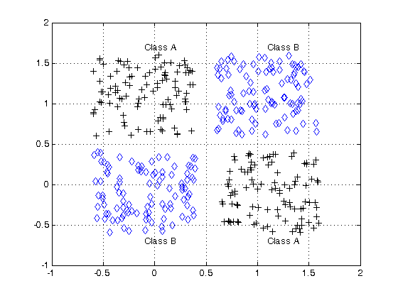
Locality or Sparsity of Computation
Minsky and Papert, 1969
Perceptron can’t do XOR classification
Perceptron needs infinite global information to compute connectivity
Locality or Sparsity is important:
Locality in time?
Locality in space?

Slide 16
Convolutional Neural Networks: shift invariances and locality

Slide 17
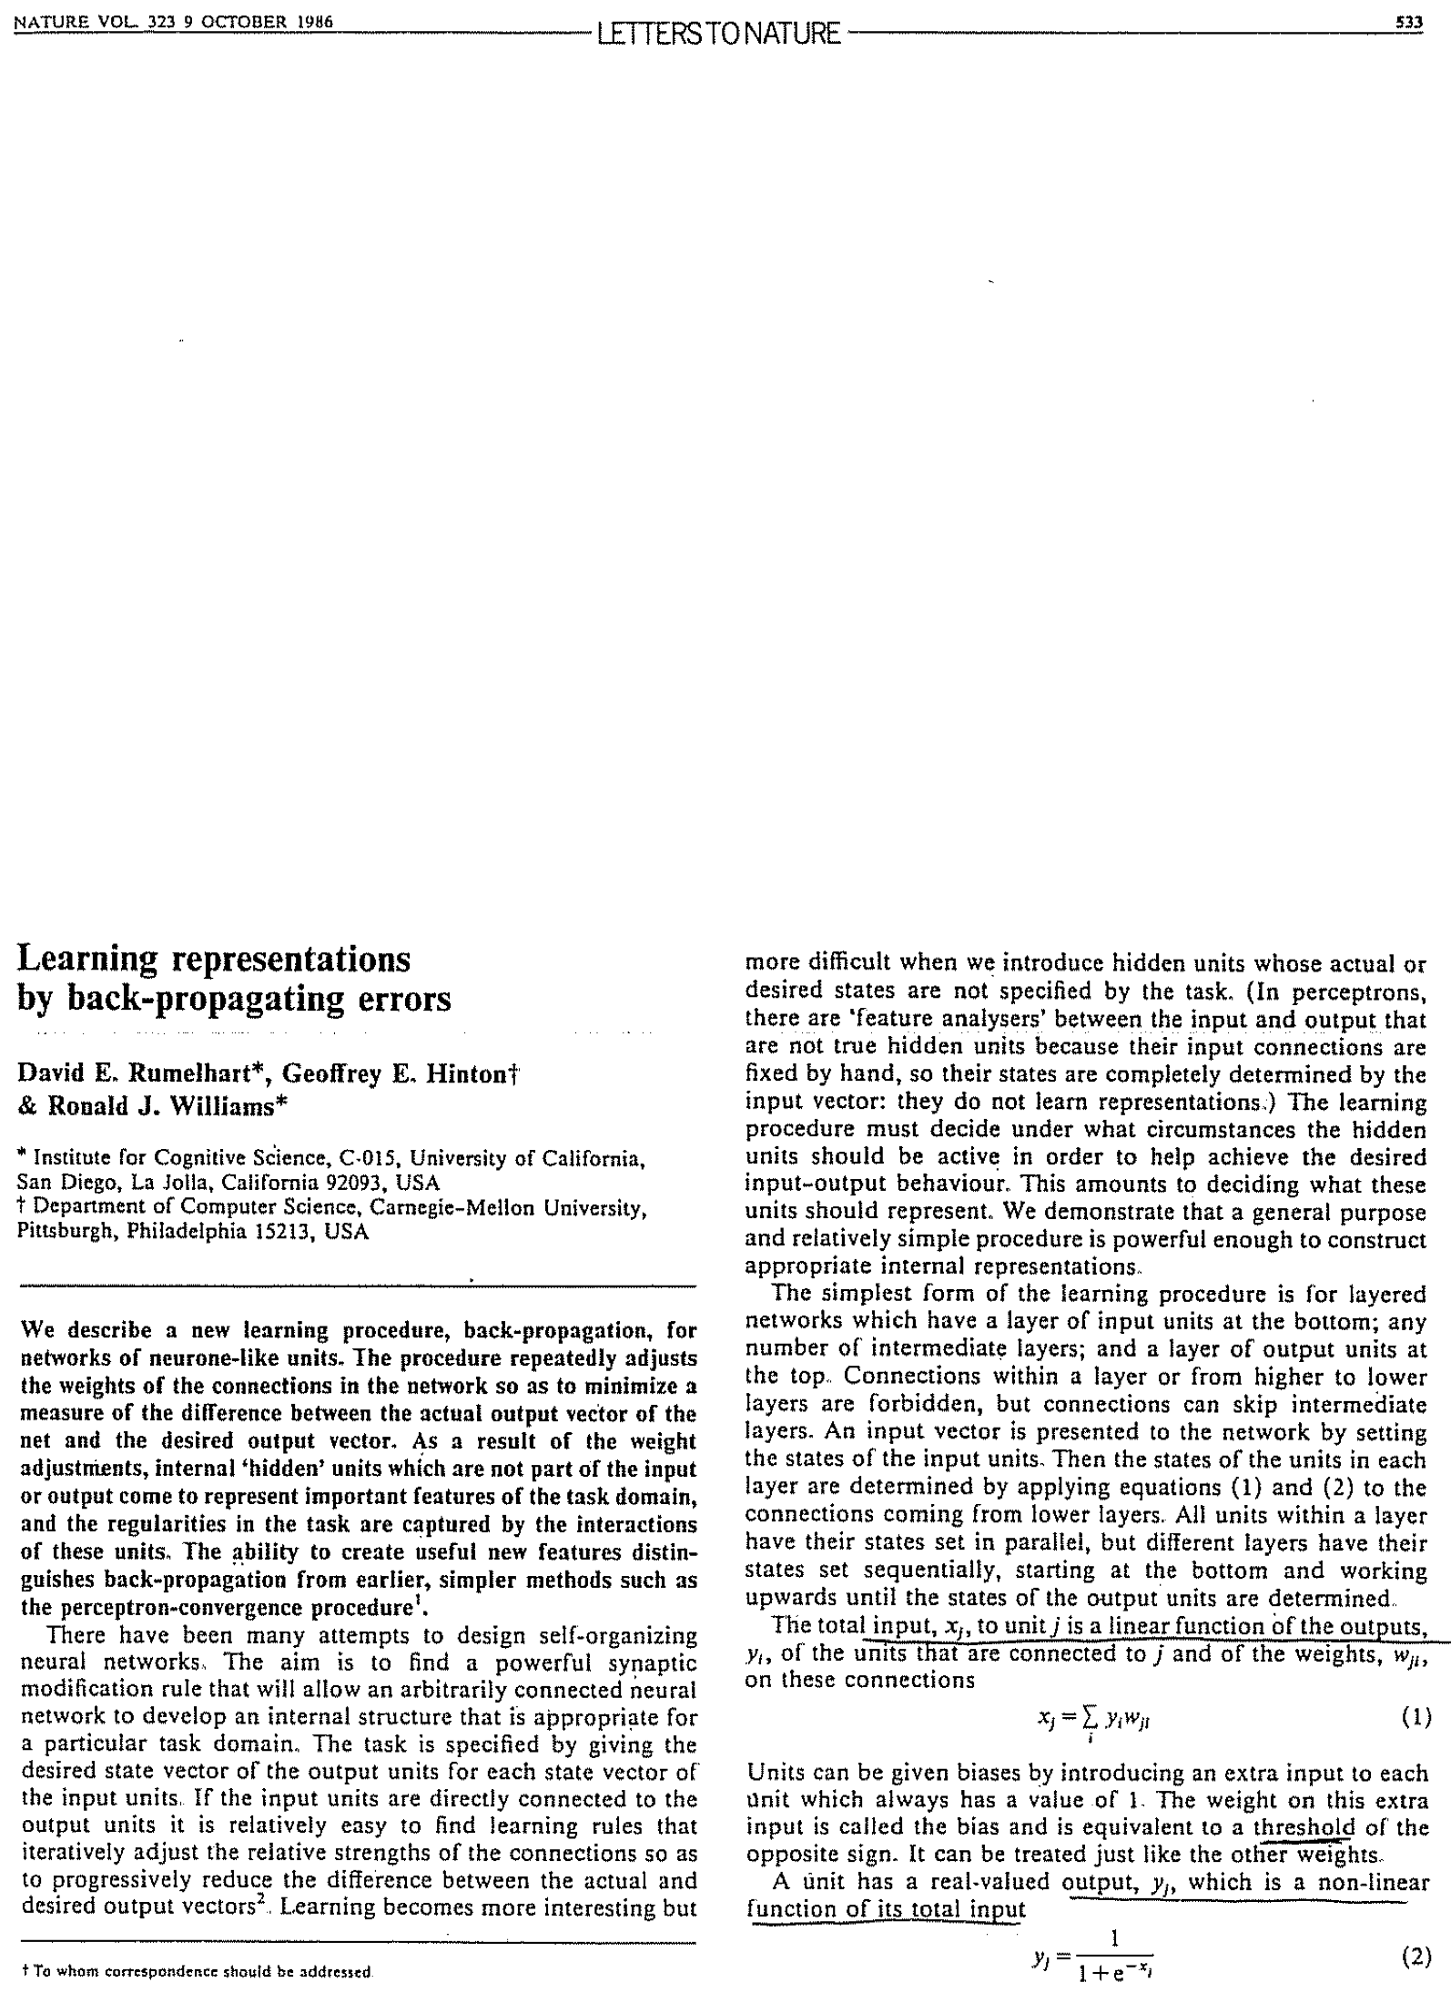
Multilayer Perceptrons (MLP) and Back-Propagation (BP) Algorithms
Rumelhart, Hinton, Williams (1986)
Learning representations by back-propagating errors, Nature, 323(9): 533-536
BP algorithms as stochastic gradient descent algorithms (Robbins–Monro 1950; Kiefer-Wolfowitz 1951) with Chain rules of Gradient maps
MLP classifies XOR, but the global hurdle on topology (connectivity) computation still exists

Slide 18
BP Algorithm: Forward Pass

Slide 19
BP algorithm = Gradient Descent Method
Other losses include cross-entropy, logistic loss, exponential loss, etc.

Slide 20
Derivation of BP: Lagrangian Multiplier LeCun et al. 1988
http://yann.lecun.com/exdb/publis/pdf/lecun-88.pdf

Slide 22
Long-Short-Term-Memory (LSTM, 1997)
Sepp Hochreiter; Jürgen Schmidhuber (1997). "Long short-term memory". Neural Computation. 9 (8): 1735–1780. (https://www.bioinf.jku.at/publications/older/2604.pdf)
BP can not train deep networks due to gradient vanishing problem etc.
Introduction of short path to train deep networks without vanishing gradient problem.
This idea will come back to Convolutional Networks as ResNet in 2015.

Slide 23
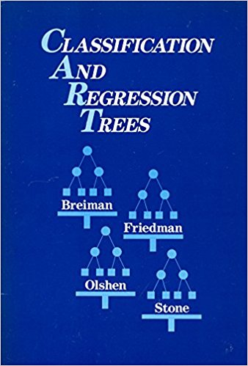
Decision Trees and Boosting
Breiman, Friedman, Olshen, Stone, (1983): CART
``The Boosting problem‘’ (M. Kearns & L. Valiant): Can a set of weak learners create a single strong learner? (三个臭皮匠顶个诸葛亮？)
Breiman (1996): Bagging
Freund, Schapire (1997): AdaBoost
Breiman (2001): Random Forests

Slide 24
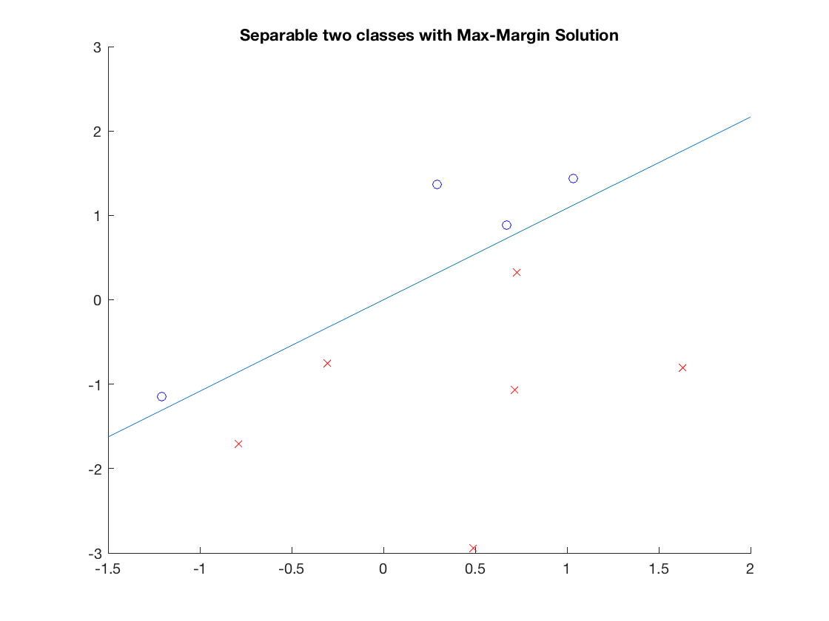
Support Vector Machine (Max-Margin Classifier)
Vladmir Vapnik, 1994
Convex optimization + Reproducing Kernel Hilbert Spaces (Grace Wahba etc.)

Slide 25

MNIST Challenge Test Error: SVM vs. CNN LeCun et al. 1998
Simple SVM performs as well as Multilayer Convolutional Neural Networks which need careful tuning (LeNets)
Second dark era for NN: 2000s

Slide 26
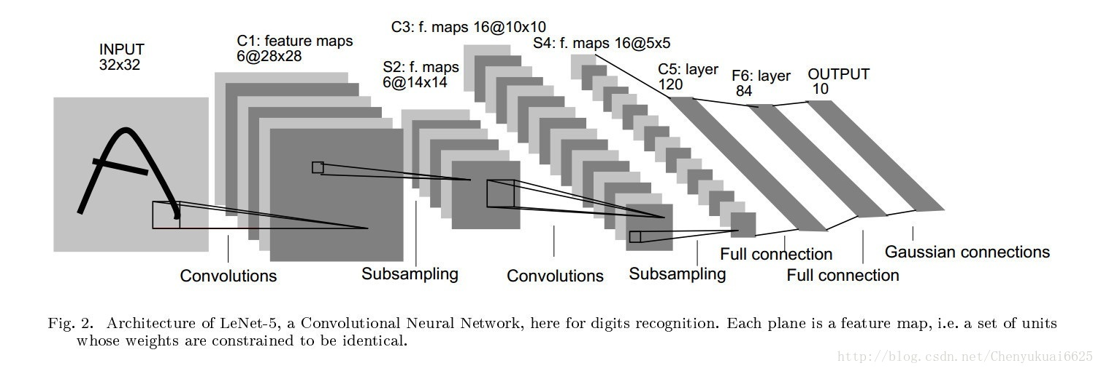
LeNet
Y. LeCun, L. Bottou, Y. Bengio, and P. Haffner. Gradient-based learning applied to document recognition. Proceedings of the IEEE, november 1998.

Slide 27
Fully Connected Layer

Slide 28
Convolution

Slide 29
Convolution Layer: a first (blue) filter

Slide 30
Convolution Layer: a second (green) filter

Slide 31
Convolution Layer

Slide 32
A Closer Look at Convolution: stride=1

Slide 33
A Closer Look at Convolution: stride=2

Slide 34
A Closer Look at Convolution: Padding

Slide 35
ConvNet:
Stride = 1
Padding = 0

Slide 36
Formula: NewImageSize = floor((ImageSize – Filter + 2*Padding)/Stride + 1)

Slide 37
ReLU

Slide 38
Max Pooling

Slide 39
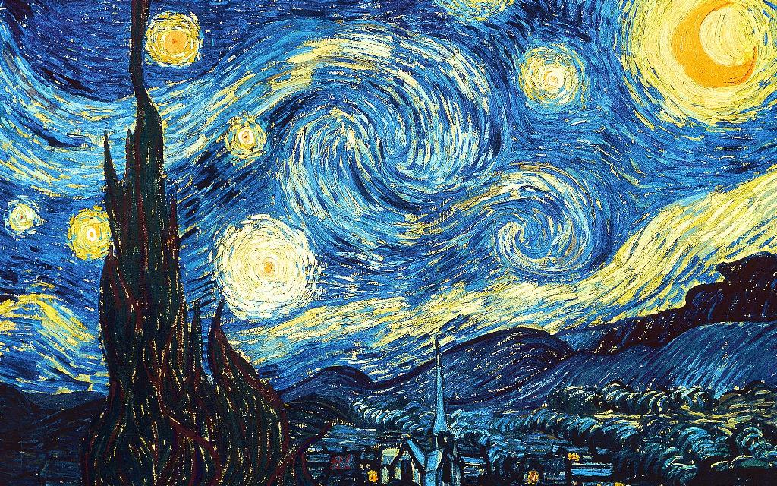
2000-2010: The Era of SVM, Boosting, … as nights of Neural Networks

Slide 40
Restricted Boltzman Machine (Deep Learning)
Hinton and Salakhutdinov, Reducing the Dimensionality of Data with Neural Networks, Science, 2006
Reinvigorating research in Deep Learning

Slide 41
Around the year of 2012…
Speech Recognition: TIMIT
Computer Vision: ImageNet
Deep Learning

Slide 42
Depth as function of year

Slide 43
AlexNet (2012): Architecture

Slide 44
AlexNet (2012): Dropout

Slide 45
VGG (2014) [Simonyan-Zisserman’14]

Slide 46
GoogLeNet [Szegedy et al., 2014]
22 layers
Efficient “Inception” module
No FC layers
Only 5 million parameters!
12x less than AlexNet
ILSVRC’14 classification winner (6.7% top 5 error)

Slide 47
ResNet (2015) [HGRS-15]
ILSVRC’15 classification winner (3.57% top 5 error)

Slide 48
Batch Normalization

Slide 49
Batch Normalization

Slide 50
BatchNorm at Test

Slide 51
Complexity vs. Accuracy of Different Networks

Slide 52
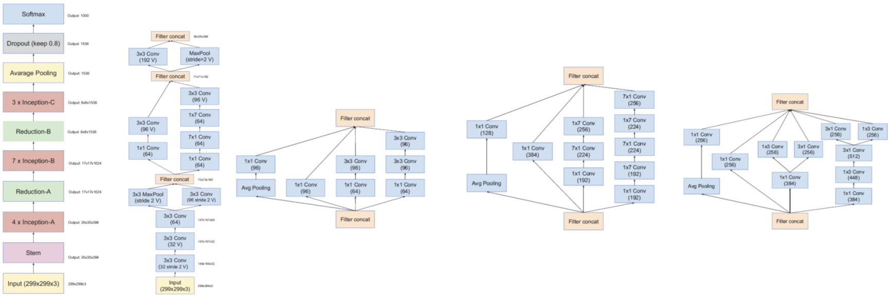
Inception-v4 = ResNet + Inception
“Inception” module:
Introduced by Szegedy et al., 2014 in GoogLeNet
ILSVRC’14 classification winner (6.7% top 5 error)
Apply parallel filter operations on the input from previous layer:
Dimensionality reduction (1x1 conv)
Multiple receptive field sizes for convolution (1x1, 3x3, 5x5)
Pooling operation (3x3)
Concatenate all filter outputs together depth-wise

Slide 53
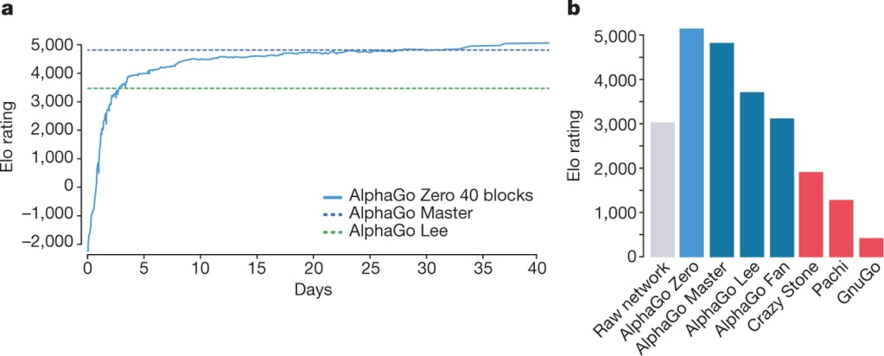
Reaching Human Performance Level in Games
AlphaGo “LEE” 2016: Monte-Carlo Tree Pruning Search+CNN
Deep Blue in 1997
AlphaGo ”ZERO” D Silver et al. Nature 550, 354–359 (2017) doi:10.1038/nature24270

Slide 54
Deep Learning Softwares
Pytorch (developed by Yann LeCun and Facebook):
http://pytorch.org/tutorials/
Tensorflow (developed by Google based on Caffe)
https://www.tensorflow.org/tutorials/
Theano (developed by Yoshua Bengio)
http://deeplearning.net/software/theano/tutorial/
Keras (based on Tensorflow or Pytorch)
https://www.manning.com/books/deep-learning-with-python?a_aid=keras&a_bid=76564dff

Slide 55
Show some examples by jupyter notebooks

Slide 56
Thank you!

